Slide 1
Cycling safely isn’t a matter of luck
Company, event, date
Name

Slide 2
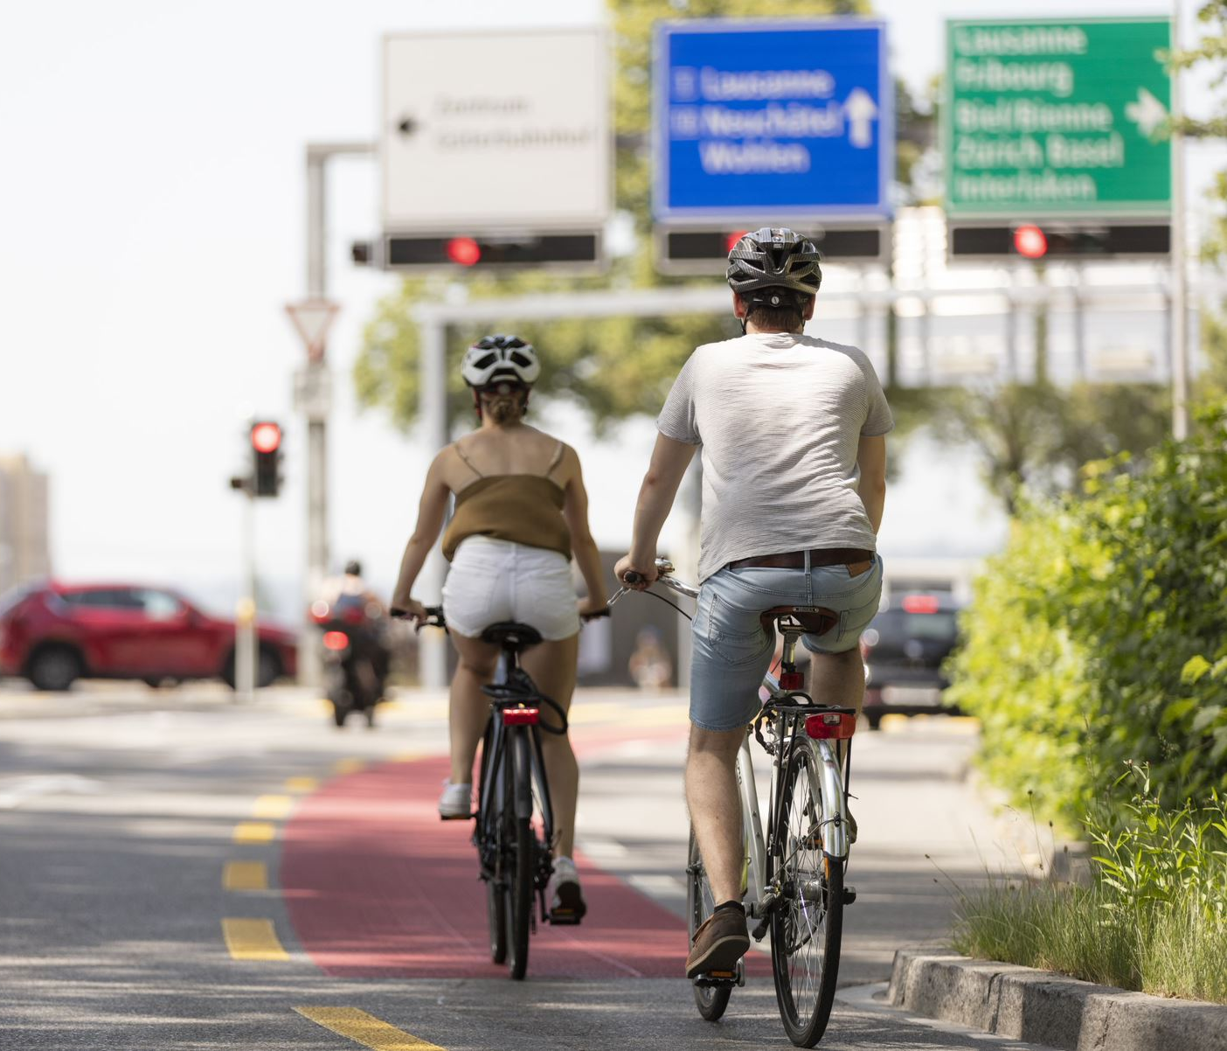
Over three million Swiss people use bicycles as a mode of transport.
Unfortunately, this also involves an accident risk.
Here’s how to travel safely:

Slide 3
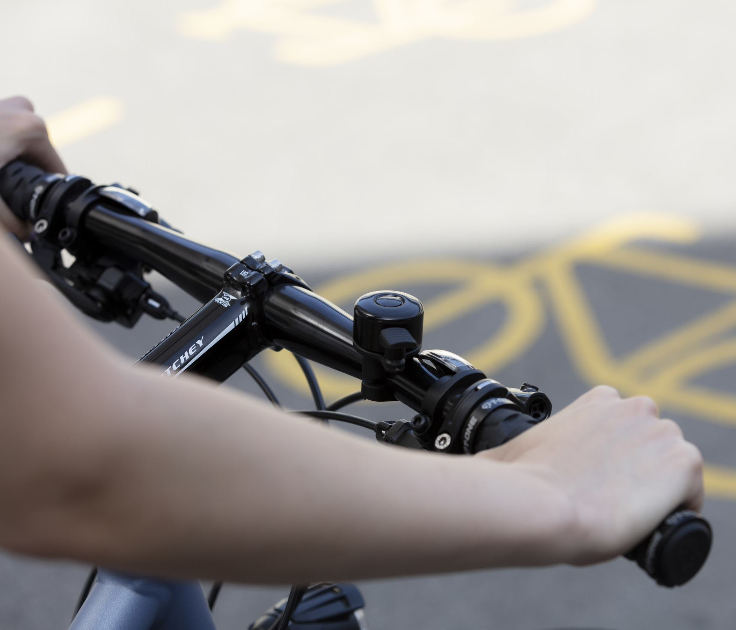
Anticipate risks and ride defensively
Anticipating risks, riding defensively and being ready to brake helps you to recognise hazards early enough and gives you sufficient time to react appropriately.

Slide 4
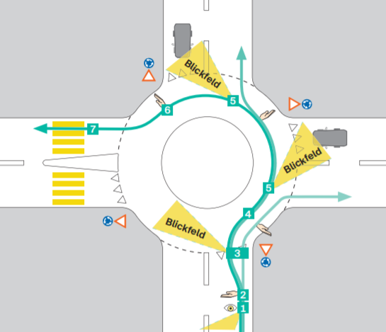
Ride in the middle at roundabouts
Ride in the middle of the lane at roundabouts. The keep-right rule does not apply here. This prevents conflicts with overtaking motor vehicles.

Slide 5
Make sure you can be seen – in daytime too
Wearing something reflective makes it easier and quicker for others to spot you. This doesn‘t just apply in poor weather, in twilight or at night, but also in the daytime.
Wear light-coloured or reflective clothing – preferably a high-visibility vest.
Wear additional reflective material at night, especially on parts of the body that are constantly in motion.
Spoke reflectors or reflective tyres make you visible from the side.

Slide 6
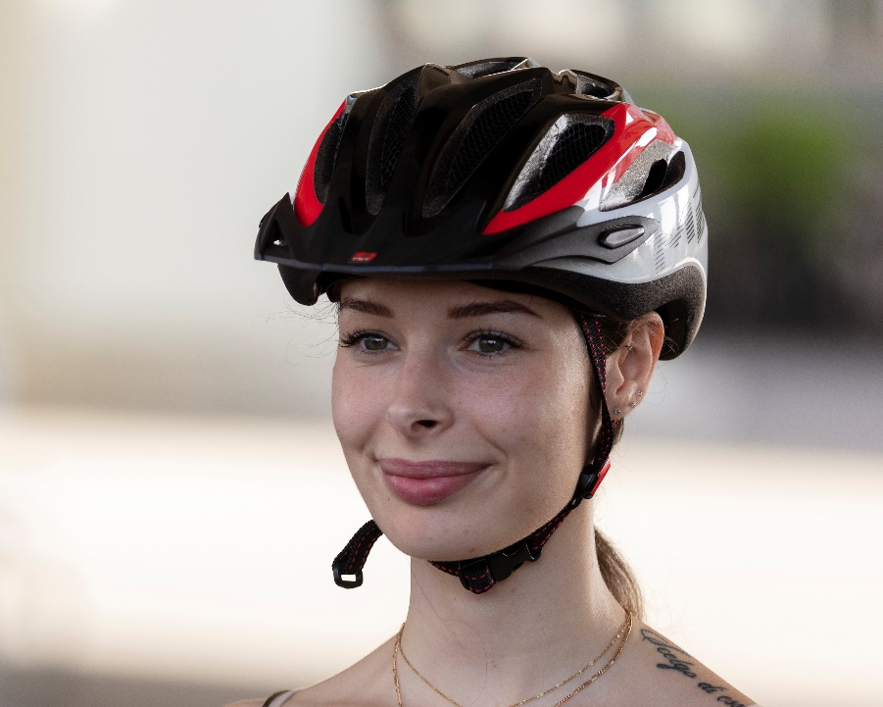
Always wear a helmet
Choose a helmet with the EN 1078 certification.
Try before you buy – your helmet should fit comfortably and neither feel too tight nor wobble.
Choose a helmet that is highly visible.
Clean it with soap and water.
Replace your helmet if it has absorbed a heavy impact or in accordance with the manufacturer‘s instructions.

Slide 7
Wear your helmet properly
Using the adjustment wheel at the back, tighten the helmet until it sits firmly without wobbling with an open chin strap.

Slide 8
Wear your helmet properly
The helmet should sit two finger widths above the bridge of your nose.
The side straps should meet just below your ears.

Slide 9
Wear your helmet properly
The side straps should be equally tight.
There should be room for one or two fingers between the strap and your chin.

Slide 10
Equip your bicycle properly
By law, bicycles must be equipped with the following:
Two steady, non-flashing lights, white at the front and red at the rear, permanently attached or removable – visible at night in fine weather at a distance of 100 m.
Permanently attached reflectors or reflective stickers with a surface area of at least 10 cm², white at the front, red at the rear, also visible at a distance of 100 m.
Pedals with reflectors at the front and rear (with the exception of racing pedals and safety pedals).
Tyres without visible fabric.
Two powerful brakes; one each for the front and rear wheel.

Slide 11
Video «Cycling safely»

Slide 12
More information
Find more accident prevention tips at bfu.ch.

