Slide 1
Better on the ball than in a hospital bed
SafetyKit Football
Company, Event, Date

Slide 2
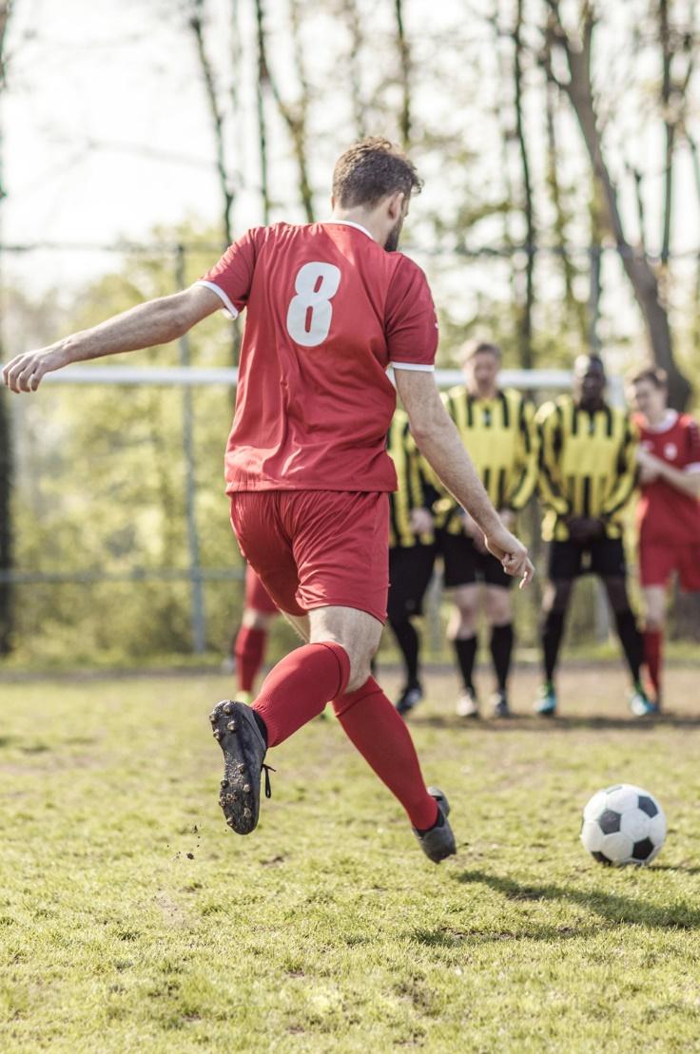
Football is one of the most popular sports in the world. And if you aren’t content with being a spectator, you can join in yourself.
But it’s not just the pros who hurt themselves while chasing the ball – over 75 000 recreational footballers fall foul of injury each year.
BFU extrapolation: number of casualties Ø 2016–2020, Swiss population

Slide 3
Properly kitted out
Wear shin guards with integrated ankle protection during every training and every match – even at grassroots tournaments and fun games.
Choose surface-appropriate football boots (studs, multiple rubber studs, indoor boots).
Remove or tape down your watch and jewellery.
Wear sports-appropriate glasses.

Slide 4
Be match ready
Warm up properly.
Always do strengthening and stretching exercises as well as stabilising exercises for your foot and knee joints and your core.

Slide 5
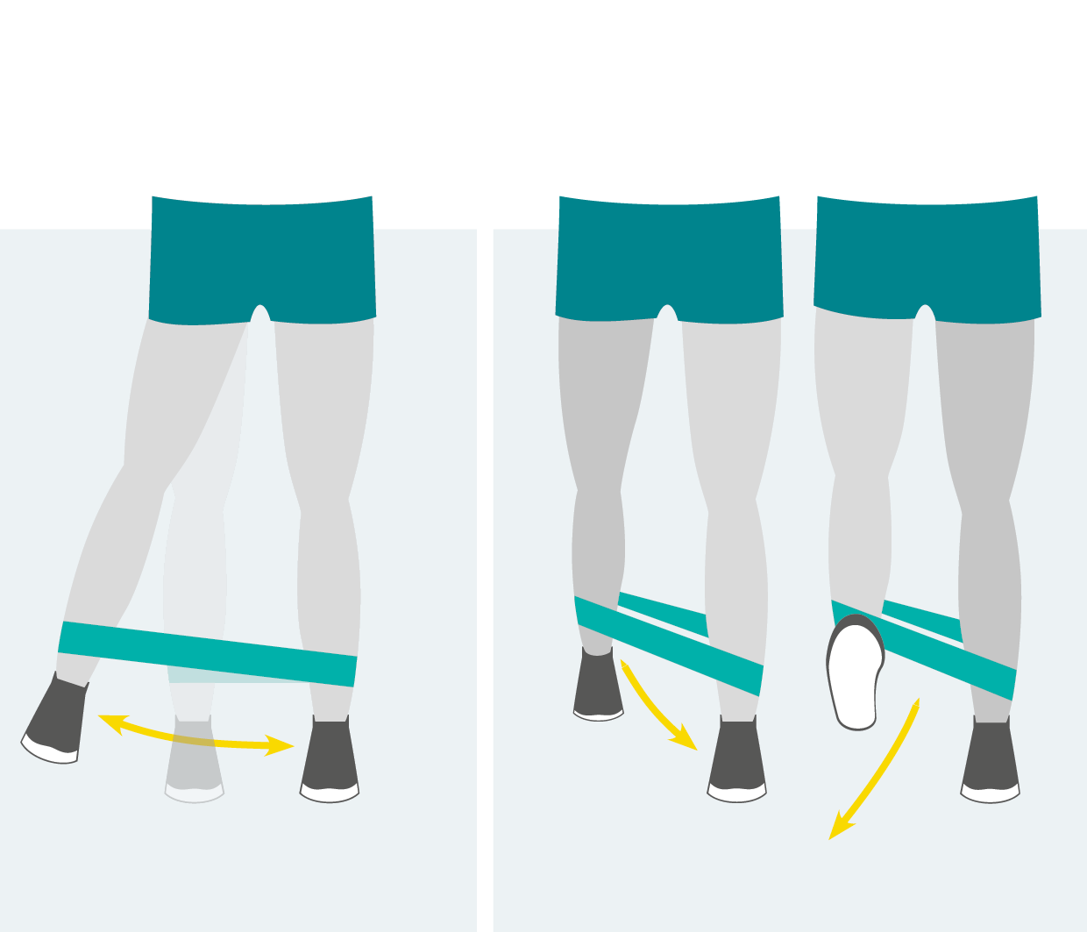
Work on your muscle strength
your joints will thank you
Abductors and adductors
Loop the mini resistance band around your legs, just above the ankles. Stand with your feet hip wide and raise one leg.
Maintaining your balance, move your raised leg out to the side and back again.
Repeat the movement and guide your raised foot back and forth.
Repeat the exercise with your other leg.

Slide 6
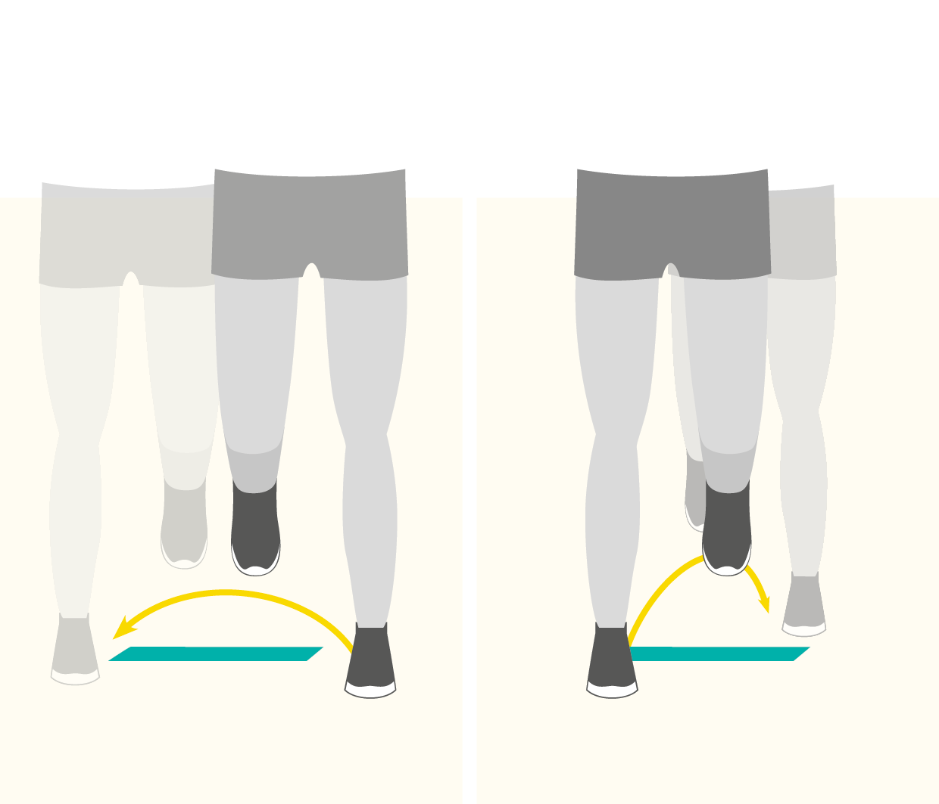
Work on your muscle strength
your joints will thank you
Ankle stability
Place the mini band flat on the floor.
Jump sideways over the band: staggered, on two legs, on one leg.
Jump forwards and backwards over the band: staggered, on two legs, on one leg.
Repeat the exercise with both legs.
Tip
You can also jump barefoot

Slide 7
Work on your muscle strength
your joints will thank you
Rules for all exercises:
Increase your training intensity step by step
Exercise regularly; preferably 2–3 times a week
Consult an expert if you experience pain while doing the exercises

Slide 8
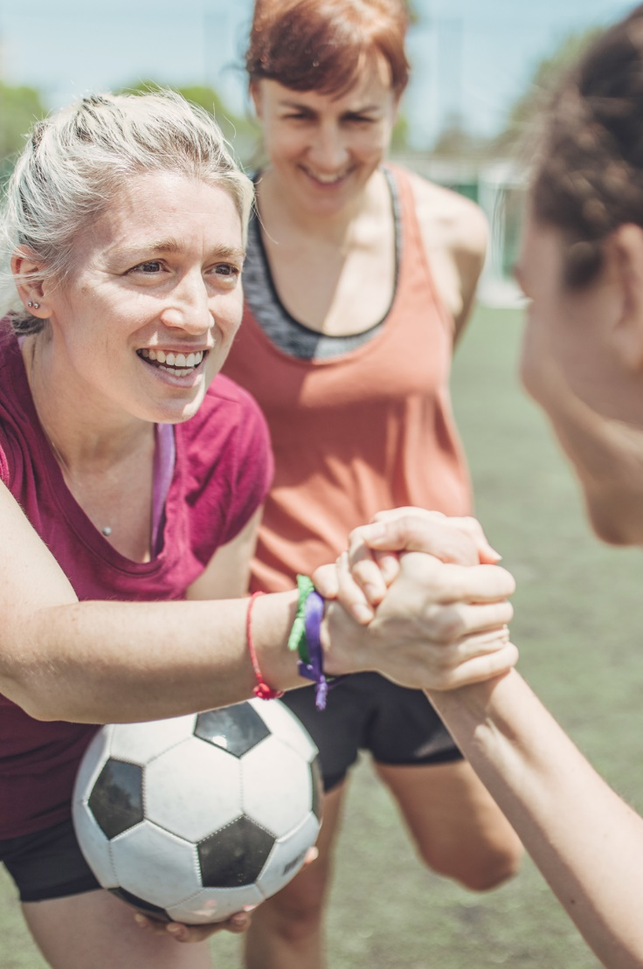
Play fair
Play by the rules of the game and use common sense.
Treat your opponent with respect and protect their health.

Slide 9
Safety first indoors (futsal)
Follow and respect the futsal rules.
Wear appropriate footwear.
Use the appropriate balls.
Notes:
What is futsal?
Futsal hails from South America (“fútbol sala” means indoor football) and is played worldwide. Futsal is primarily characterised by a special set of rules to protect the players: almost all physical contact is prohibited. Futsal is also played with a “low bounce” ball.

Slide 10
More information
Find more accident prevention tips at bfu.ch.

